Slide 1

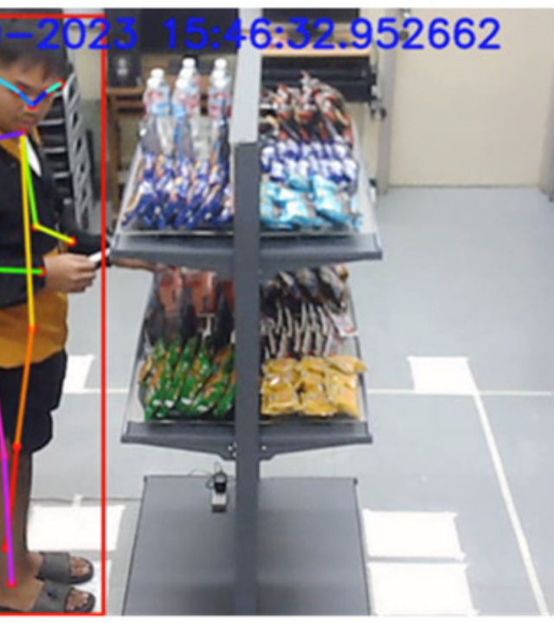
The Retail Analytics Gap
The Problem
Current systems track "Shelf Pickup" but are blind to the critical "Holding & Inspecting" phase.
Key Challenges
Fine-Grained Occlusion: Hands often cover specific identifying features of the product.
Extreme Angles: Viewing perspectives often range from 45 ∘ - 90 ∘ .
Lighting: Glare and reflections are common in store environments.
Goal: Detect missed opportunities (products examined but not bought).

Slide 2



Project Task & Novelty
Formal Task
Develop a robust vision system to classify specific Album IDs from hand-held views, even when 50% of the cover is hidden.
Input: RGB Frame (Cropped Hand)
Output: Class ID & Confidence Score
The Novelty
Few-Shot Learning: Addressing data scarcity (learning from 10-20 seed images).
Solution: Using SDXL + ControlNet to create rich synthetic data (Advanced Data Augmentation).

Slide 3
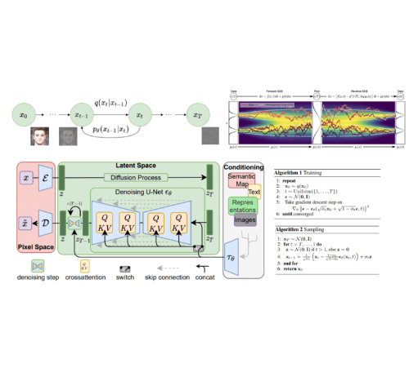
Models & Methods
The GenAI Pipeline
1
Seed Data: Collection of 10-20 clean catalog images.
Generation: SDXL + ControlNet + Inpainting.
Training: Transfer Learning (ImageNet Pre-trained).
Eval: Test on Real Images.
Identity Preservation
Crucial Step: Using IP-Adapter. This ensures the generated record maintains the semantic identity of the original album, preventing it from becoming a "generic record".

Slide 4
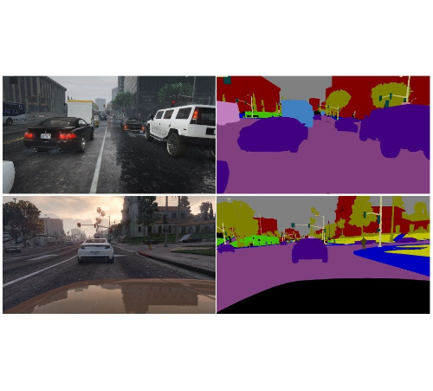



Training Data Strategy
We bridge the gap between "Catalog" and "Real World" using synthesis.
20
Real Seed Images (Per Class)
Clean, front-facing images from web.
1k
Synthetic Images (Per Class)
Generated with varied hands, lighting, angles.
Real Test Set (Manual Collection)
Manually collected real images for reliable validation. NOT Synthetic!

Slide 5
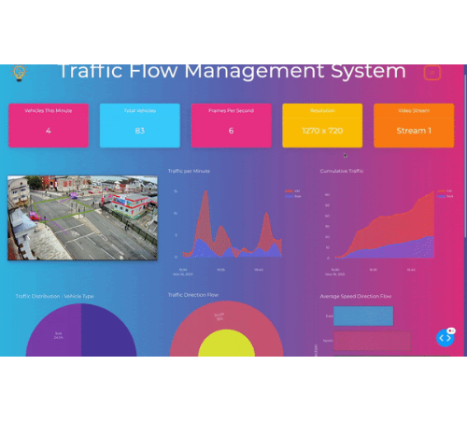
Metrics & KPIs
1. Classifier KPIs
Standard metrics evaluated on the Held-out Real Test Set:
Top-1 Accuracy
Top-5 Accuracy
Precision / Recall
2. Generator KPIs
Ensuring the synthetic data is high quality:
FID Score: Visual realism.
Cosine Similarity: (using CLIP/DINO) Measures semantic identity.
3. The "Gap" Experiment
Comparing performance: Model trained on Real Only (Few-Shot) vs. Model trained on Synthetic Data.

